Slide 1

Hotel Transactions Analysis Report
Prepared by: Rahma Muhamed Hashem Under the supervision of Eng. Hossam Muhamed Date: July, 2025

Slide 2
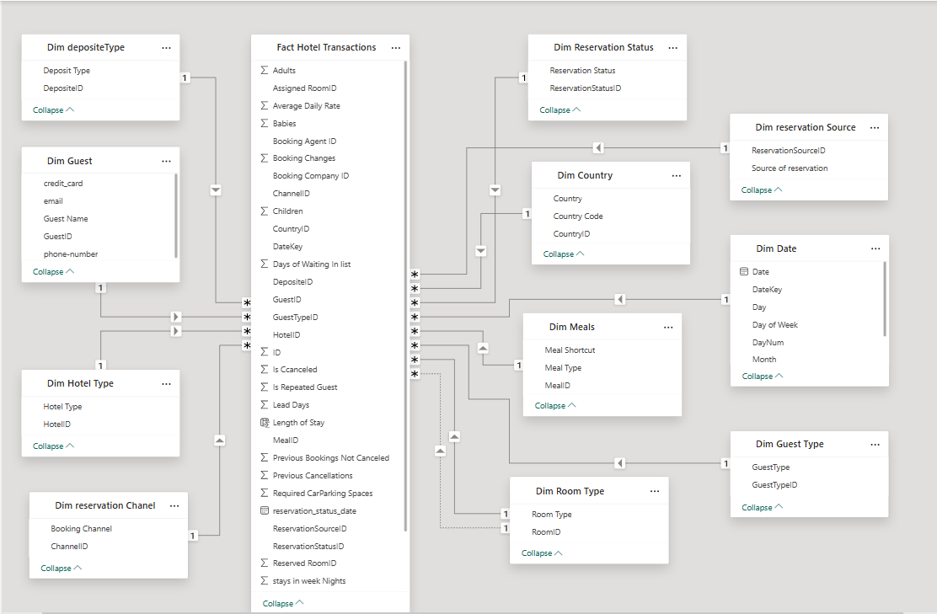
The Model

Slide 3
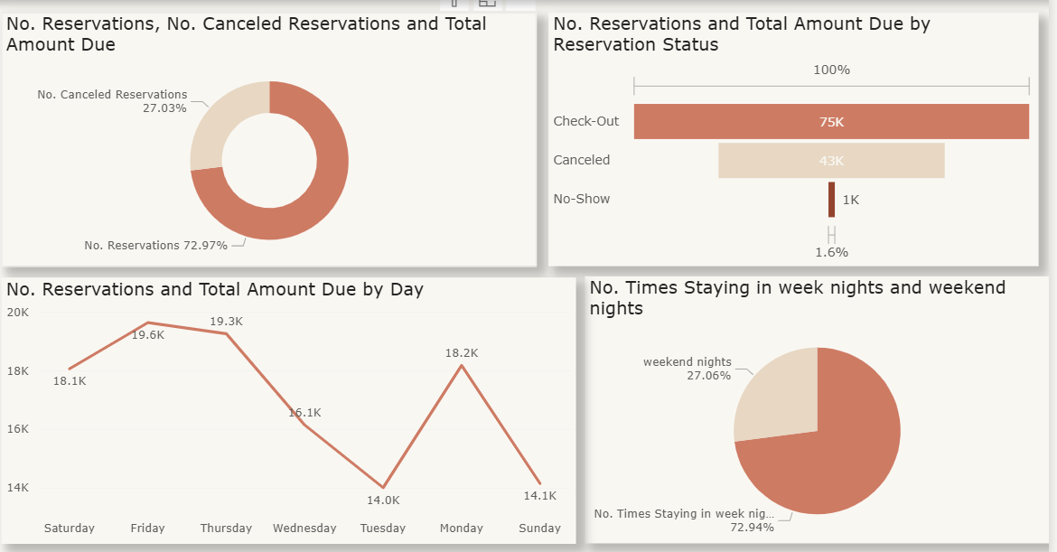
General Dashboard

Slide 4
Dashboard Insights (Reservation Performance)
Insight 1: High Cancellation Rate
From the donut chart:
27.03% of reservations were canceled.
72.97% were completed.
Suggested Action: Review and tighten cancellation policies. Introduce "non-refundable" discounts or send pre-arrival reminders to reduce last-minute cancellations.
Insight 2: Most Revenue Comes from Completed Reservations
From the horizontal bar chart:
75K from 'Check-Out' reservations
43K from 'Canceled', and
Only 1K from 'No-Show'
Suggested Action: Focus on converting bookings into actual stays. Enhance guest engagement before arrival to reduce no-shows and boost revenue.

Slide 5
Insight 3: Highest Booking Volume on Thursdays and Fridays
From the line chart:
Friday: 19.6K, Thursday: 19.3K
Lowest day: Tuesday with 14K
Suggested Action: Increase rates slightly on peak days (Thursday & Friday). Launch midweek offers or campaigns to boost traffic on slower days like Tuesday.
Insight 4: Majority of Stays Are on Weekdays
From the pie chart:
72.94% weekday stays
27.06% weekend stays
Suggested Action: Introduce special weekend packages targeting families, couples, or leisure travelers to balance the occupancy between weekdays and weekends.

Slide 6
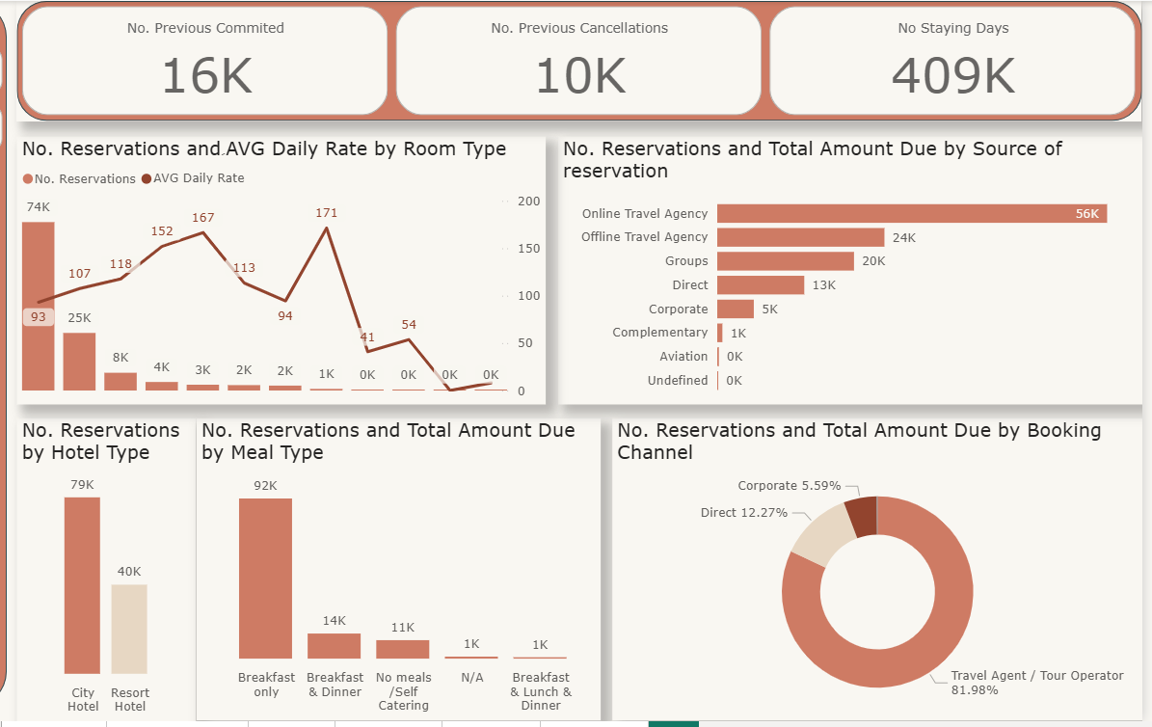
Reservations Dashboard

Slide 7
Insight 1: Most Booked Room Type Is Mid-range, Not the Highest Paying
The highest number of reservations (~93) came from a room type with only 25K in revenue.
However, Room Type with only 41 reservations had the highest Average Daily Rate (ADR) of 171.
Suggested Action : Promote high-ADR room types through upselling or packaging strategies. Balance occupancy vs. revenue focus.
Insight 2: Online Travel Agencies Dominate Booking Sources
56K total amount came from Online Travel Agencies, more than double any other source.
Suggested Action : Strengthen partnerships with OTAs, but monitor commission impact. Consider investing in direct booking incentives to increase margins.
Insight 3: City Hotels Are Booked Twice as Much as Resort Hotels
City Hotels: 79K reservations
Resort Hotels: 40K
Suggested Action : Explore reasons behind lower resort bookings (seasonality, accessibility, pricing) and launch tailored promotions.

Slide 8
Insight 4: Most Guests Choose “Breakfast Only”
92K reservations came with only breakfast included.
Very low adoption of full-board options like “Breakfast & Lunch & Dinner”.
Suggested Action : Introduce attractive meal upgrades or bundling. Offer discounts for adding lunch/dinner at booking stage.
Insight 5: Booking Channels Are Heavily Skewed
Travel Agent / Tour Operator accounts for 81.98% of bookings.
Direct and Corporate are very small portions (12.27%, 5.59%).
Suggested Action : Reduce over-dependence on intermediaries. Promote direct booking via hotel website or loyalty programs.

Slide 9
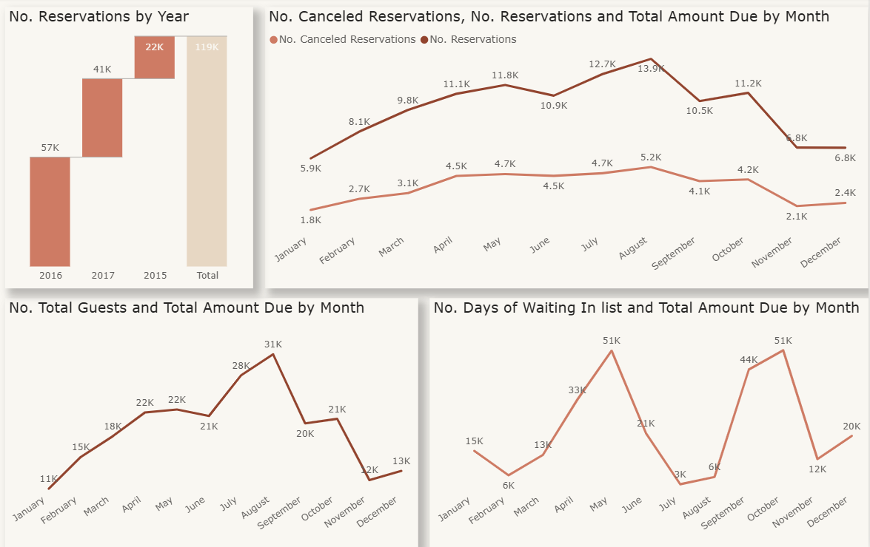
Time Dashboard

Slide 10
Insights
57K reservations in 2016, compared to 41K in 2017 and 22K in 2015.
Suggested Action: Analyze the key drivers behind the strong performance in 2016 (promotions, seasons, partnerships...) and aim to replicate or enhance them in future years.
51K waiting days recorded in May and November! Suggested Action: Increase operational capacity during peak months or enhance waiting list management (e.g., offering alternative packages to guests).
13.9K reservations in August, followed by July and May.
Cancellations were higher in March and April compared to other months.
31K total guests in August, followed by 28K in July and 22K in September.

Slide 11
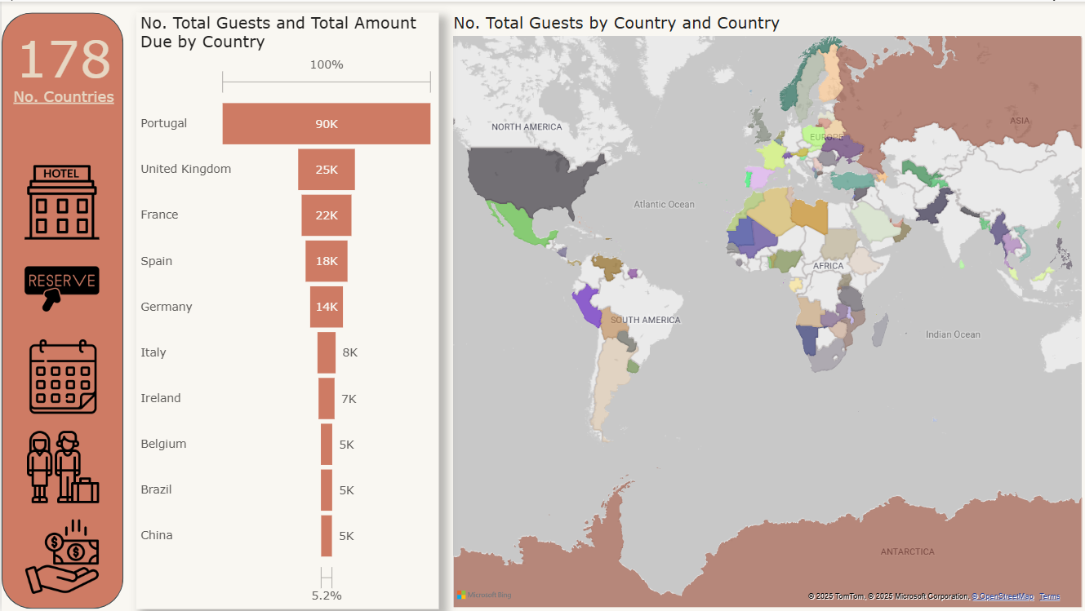
Country Dashboard

Slide 12
Insights
The map shows the countries from which the guests come, and it is clear that they are numerous, as seen on the map.
The top 10 countries in terms of the number of guests are displayed, with Portugal ranking as the highest.

Slide 13
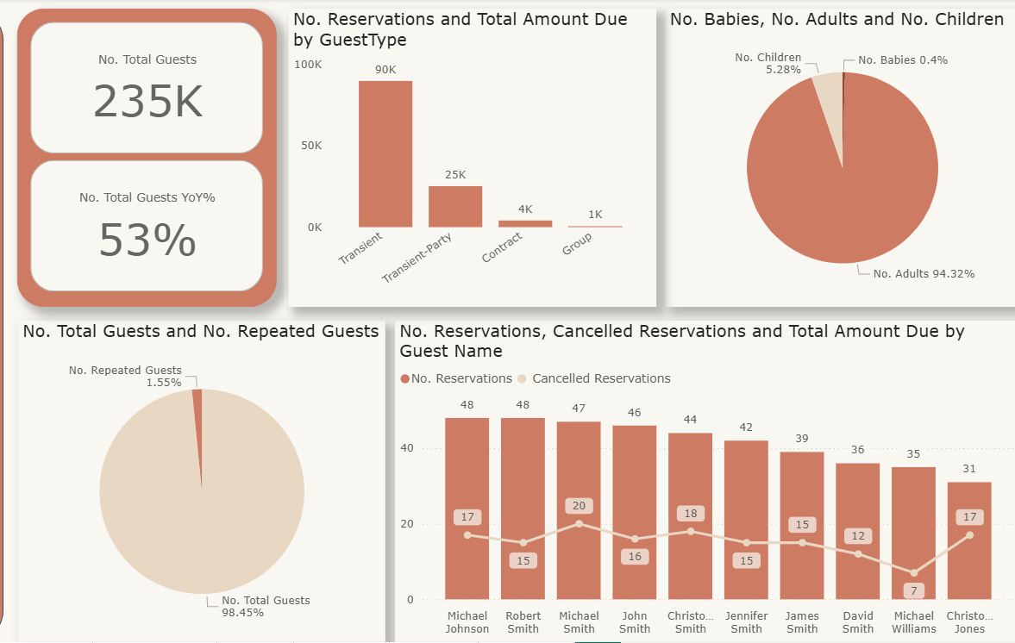
Guests Dashboard

Slide 14
Insights
Approximately 95% of the hotel guests are adults, which indicates that focus should be placed on providing activities and attractions that appeal to this demographic.
Around 75% of the guests fall under the "transient" category.
The percentage of returning guests is about 1.5% of the total number of visitors, which is a very low rate. This point requires further investigation to understand why guests are not returning.
By analyzing the top 10 customers in terms of the number of bookings, and comparing that with their number of canceled bookings, it appears that the net number of bookings is not correlated with the number of cancellations, but correlated with the total number of bookings.

Slide 15
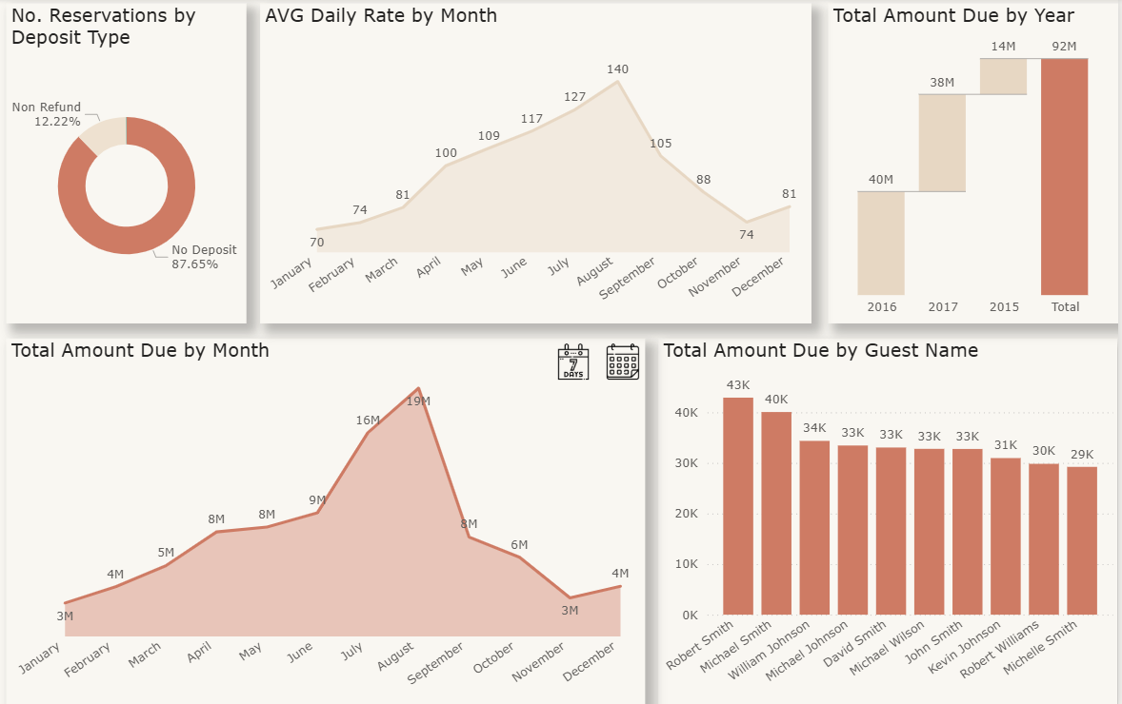
Amount Dashboard

Slide 16
Insights
The chart clearly shows that the increase in total revenue is related to the rise in the number of hotel bookings, which indicates the need to focus on increasing bookings to boost overall revenue.
It is also evident that the average room price tends to rise during periods of high booking volume.
The third quarter of the year appears to be the peak season for hotel bookings. It is recommended to work on attracting customers during the rest of the year, while ensuring full preparedness for the high-demand season.
Approximately 89% of guests prefer to book without paying a deposit.
A list of the top 10 guests in terms of the revenue they generate for the hotel is also available.

